Slide 1



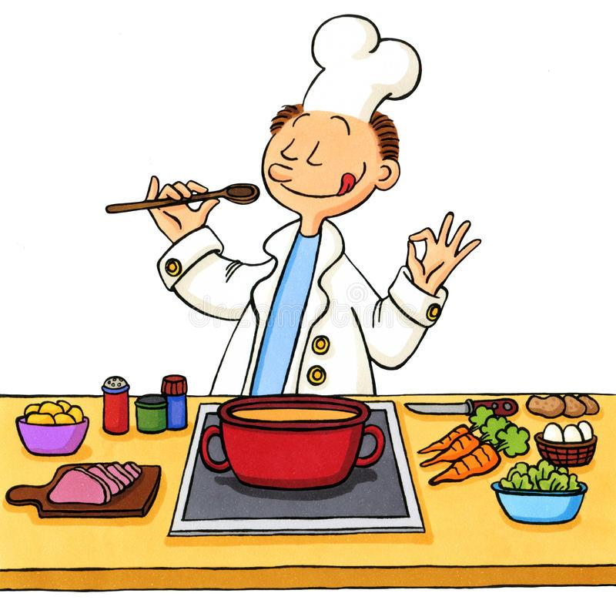
HOMEM DE REC PE BOWL
Your Ingredients, Our Recipes
Team:
18103018 Ankit Goyal
18103027 Krish Garg
18103035 Divyanshu Garg
18103039 Anish Aggarwal

Slide 2
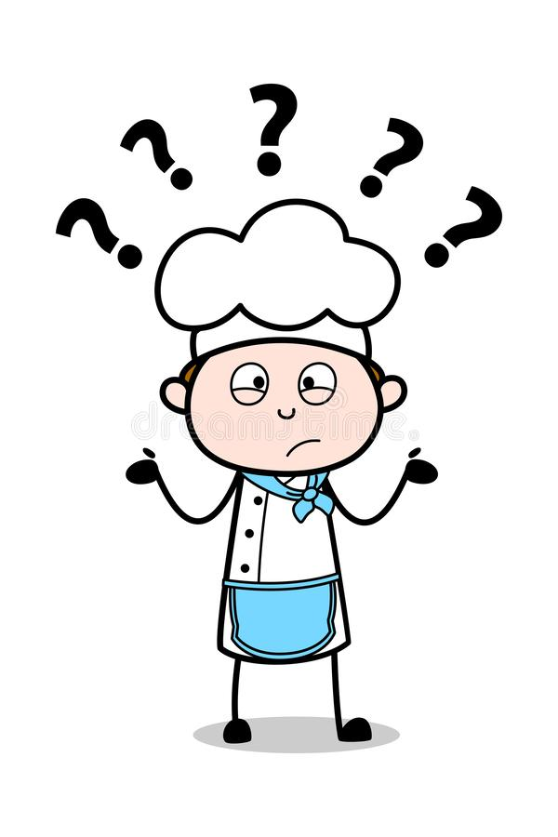
Problem Statement?
Often, people get into a situation that they want to cook something delicious but are short on ingredients at home.
Many times people see an image of a delicious looking dish, but they don't know it’s recipe.
We aim to make a user aware about the various dishes which can be cooked from available set of ingredients or an input image given by a user.

Slide 3
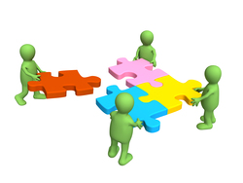
Our Contribution...
What already exists:
Recipes-by-name search system
Recipes recommender search system
Existing Problems:
No Recipes-by-Ingredients search system
No Recipes-by-Images search system
No Ingredients-Recipe and Image-Recipe datasets.
Our Contribution:
Scraped Ingredients-Recipe and Image-Recipe datasets.
Training Image-to recipes model using Convolutional Neural Network
Recipe generator using character-level RNN text generation ML technique.

Slide 4
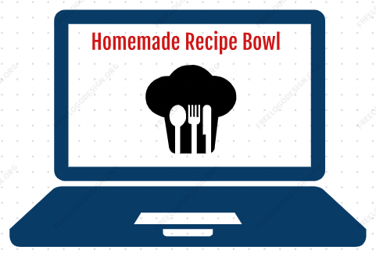
What is Homemade Recipe Bowl?
A dynamic website incorporating machine learning techniques.
Search options:
Search by Ingredients
Search by food image
Search by cuisine
Output: self generated recipes
It is a recipe generator system and
not a recommender system!!

Slide 5





Technologies used...
Website front end: React, CSS, HTML, JavaScript, JQuery, AJAX
Website Back end: Flask (Python Framework)
Database: SQLite
Deep learning: Tensorflow and Keras Framework
Web Scraping: BeautifulSoup (Python)

Slide 6
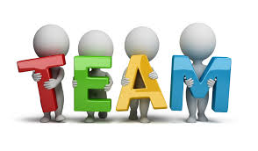
Timeline...
Week 0
(28 July 2020 - 9 August 2020)
Team formation and Mentor Selection:
Team Member Formation.
Choosing the field/technology of interest after a series of meetings with the team members.
Selecting the appropriate mentor best suited for the technology to be used.

Slide 7
Week 1
(10 August 2020 - 16 August 2020)
Project Idea Discussion and Synopsis Drafting:
Came up with three project ideas:
A gaming project which uses physical movement detection for moves in the game. This would collaborate exercise with gaming.
Personal voice assistant software and hardware for blinds to detect the objects around.
Platform for generating recipes based on given set of ingredients. This was influenced by the cooking trend during lockdown situation.
Finally, we decided to take up the third idea, as we found it to be a more practical and useful idea. And also it was feasible according to our knowledge and skill set.

Slide 8

Week 2
(17 August 2020 - 23 August 2020)
Discovering Project Requirements:
Looking onto the existing work in this related field, if done.
Deciding the further contributions we can make.
Looking for availability of datasets for training purposes of our models to be able to predict the required output.
Looking for platform to perform high end computations like web scraping and machine learning model training.
Developing a user interface through which the user can access all the functionality easily and innovatively.

Slide 9
Software Requirements Specification (SRS)
Purpose: to develop a system which primarily is capable of generating extensive recipes out of given set of ingredients.
Intended Audience:
Any person of any age group, any region and any profession who loves exploring food.
A very large size audience!!!
Scope:
Fetch/Scrap relevant dataset
Decide upon apt deep learning technique for text generation
Train the ML Model on variations of hyper parameters
Develop hitech and easy-to-use user interface system

Slide 10
Product Features:
Ingredients-to-recipe feature
Image-to-recipe feature
Nutritional analysis for every recipe
User Interface Requirements:
Easy to use dynamic website which runs on exhaustive set of devices and which is capable of handling heavy user load.
Hardware Requirements:
High end computational machine required for Web Scraping and ML Model training if required.
Software Requirements:
3rd Party dependencies required for Web Scraping (like BeautifulSoup, JSoup), Model Training script (like Tensorflow, Keras, Pytorch) and Web interfaces (React or Vue for frontend, Flask, Express or Django for backend).

Slide 11
Week 3
(24 August 2020 - 30 August 2020)
Exploring datasets and websites for scrapping (if required):
Looked up for the existing datasets on the internet.
Found one nearly exhaustive dataset by MIT, but the access was not public, wasn’t accessible.
Could not find any other dataset related to the Recipe name along with ingredients and instructions.
Created the Github Repository for the project - Homemade Recipebowl (Currently the repository is private)

Slide 12

Week 4
(31 August 2020 - 6 September 2020)
Scraping Websites:
Shortlisted three websites suitable for ingredient-recipe dataset:
Epicurious
All Recipes
Food Network
Developed the code for scraping in python.
Scraped the websites using the BeautifulSoup module in python.

Slide 13
Week 5
(7 September 2020 - 13 September 2020)
Designing UML Diagrams:
Use Case Diagram
Class Diagram
Sequence Diagram
Activity Diagram
State chart Diagram
Deep Learning Course:
Took a brief overview of the deep learning specialization on Coursera by Andrew NG.
Also referred to some online articles and tutorials regarding NLP.

Slide 14
USE CASE
DIAGRAM

Slide 15
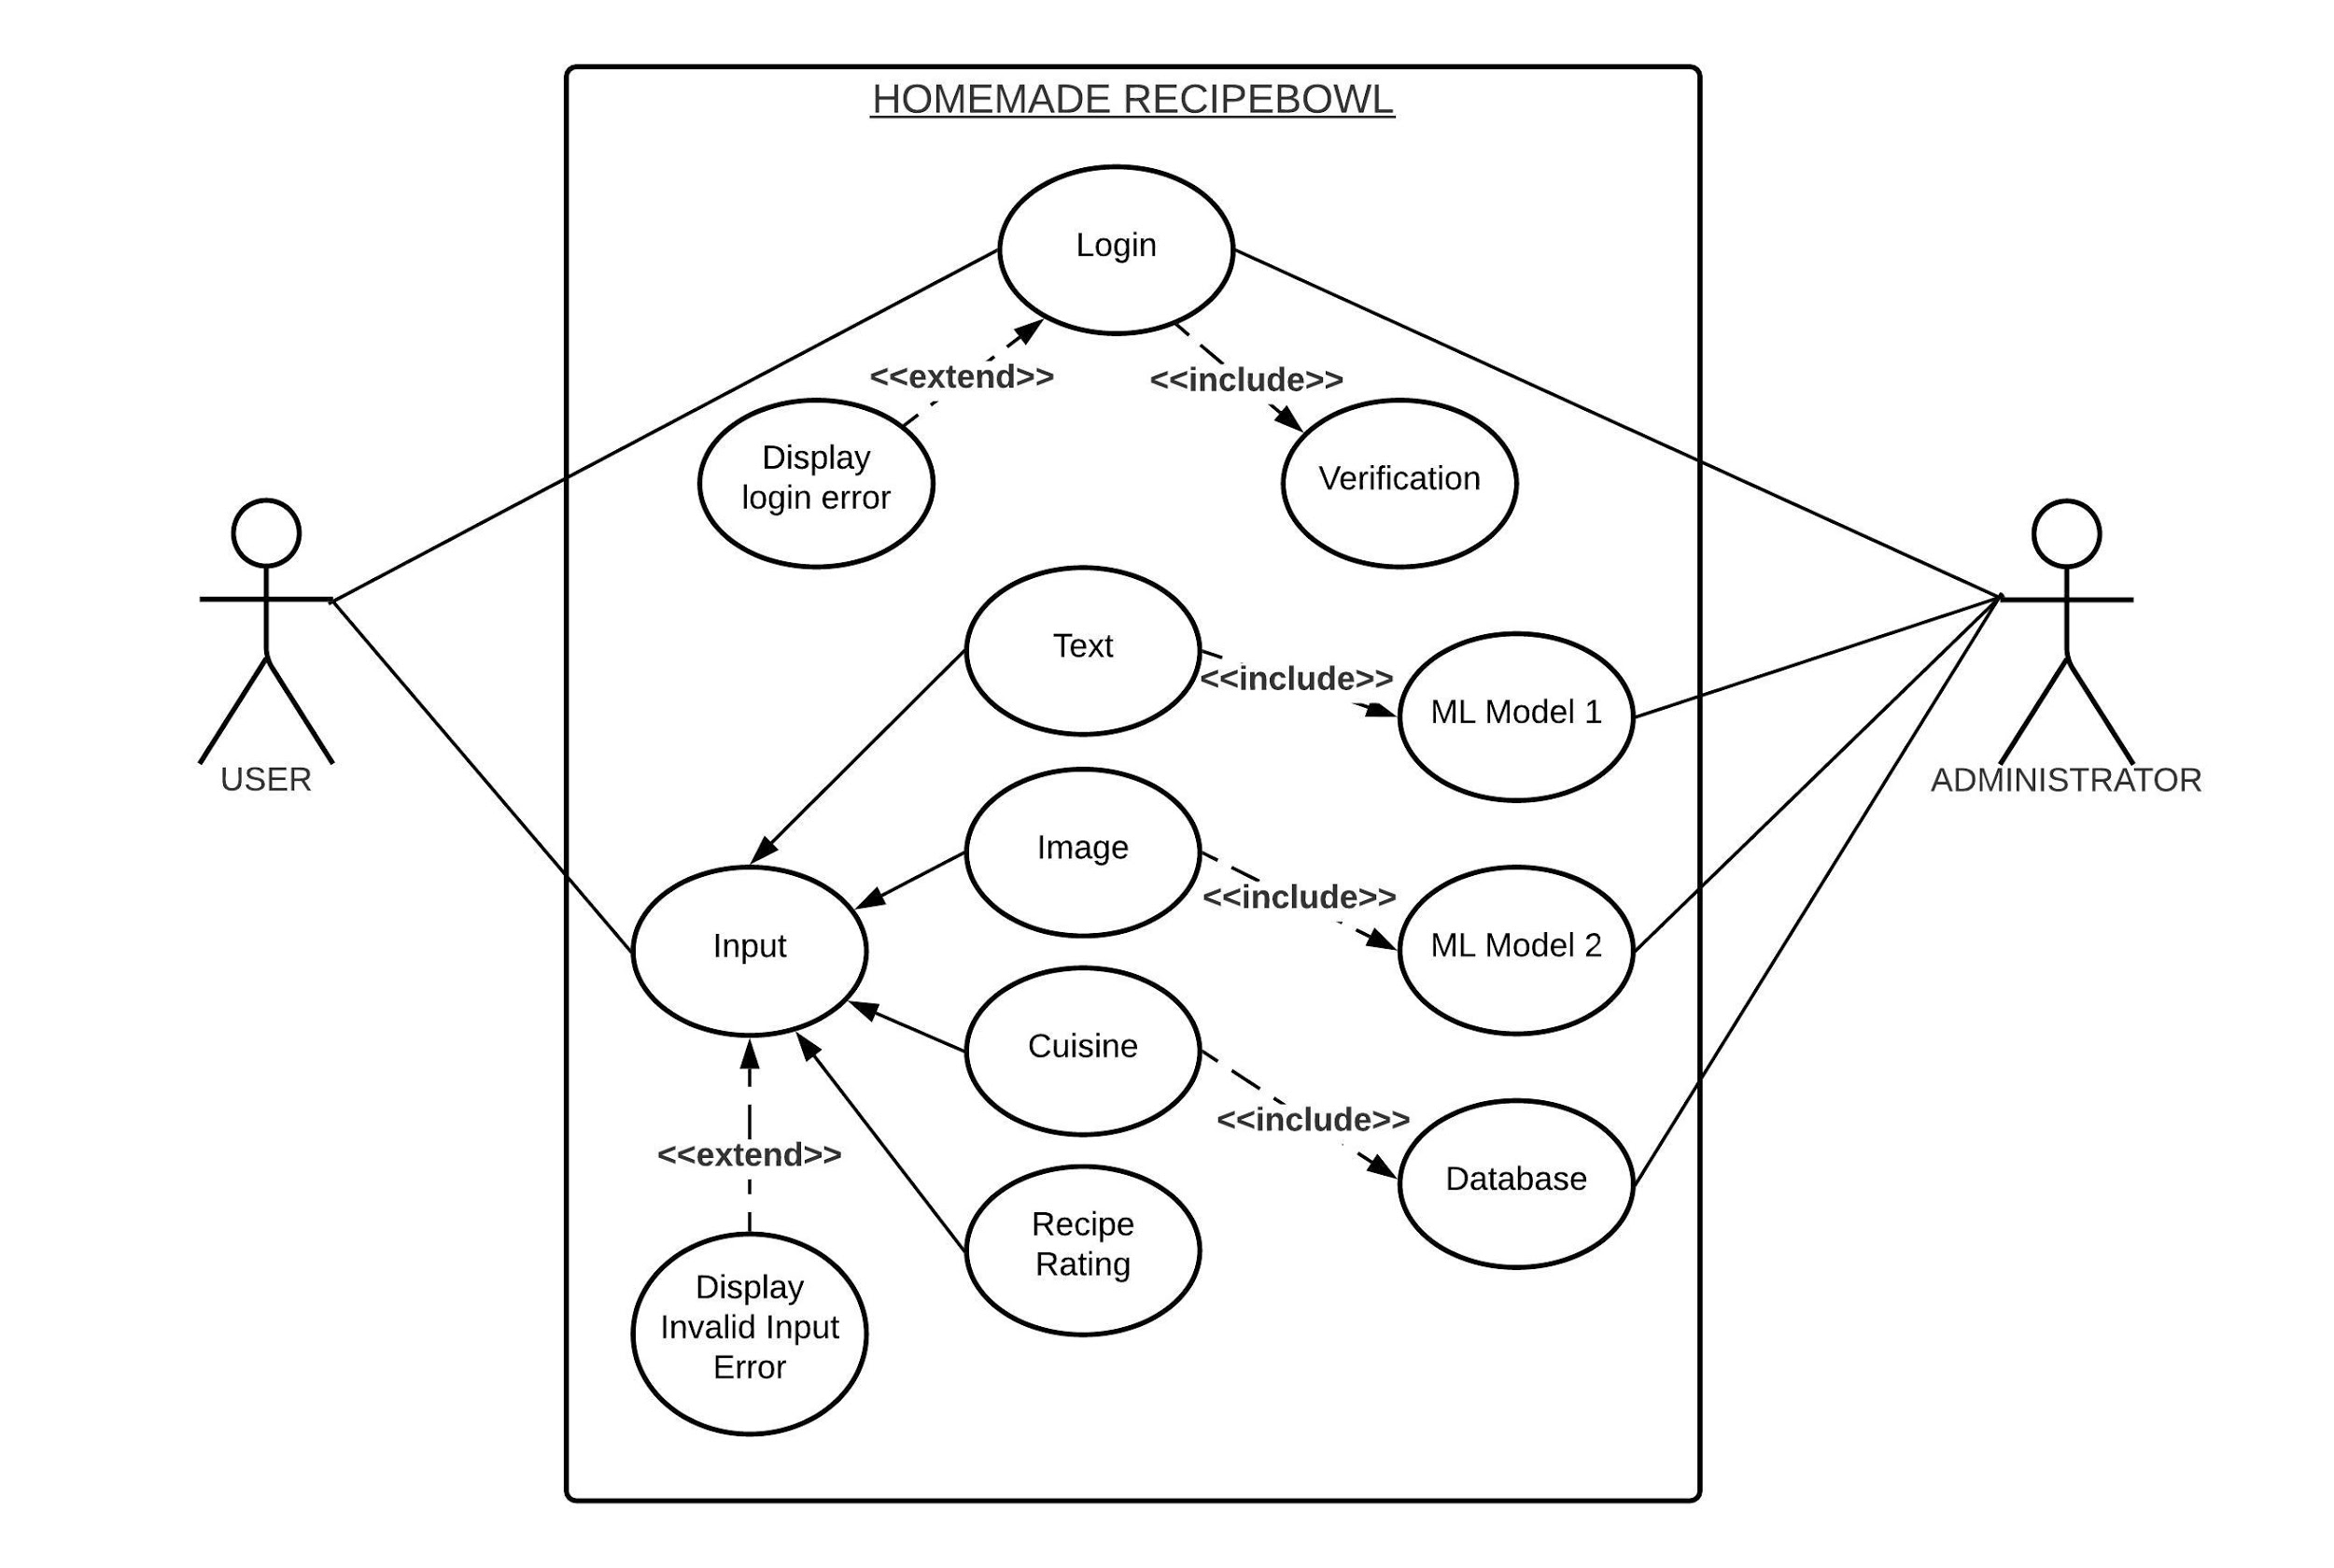


Slide 16
CLASS
DIAGRAM

Slide 17
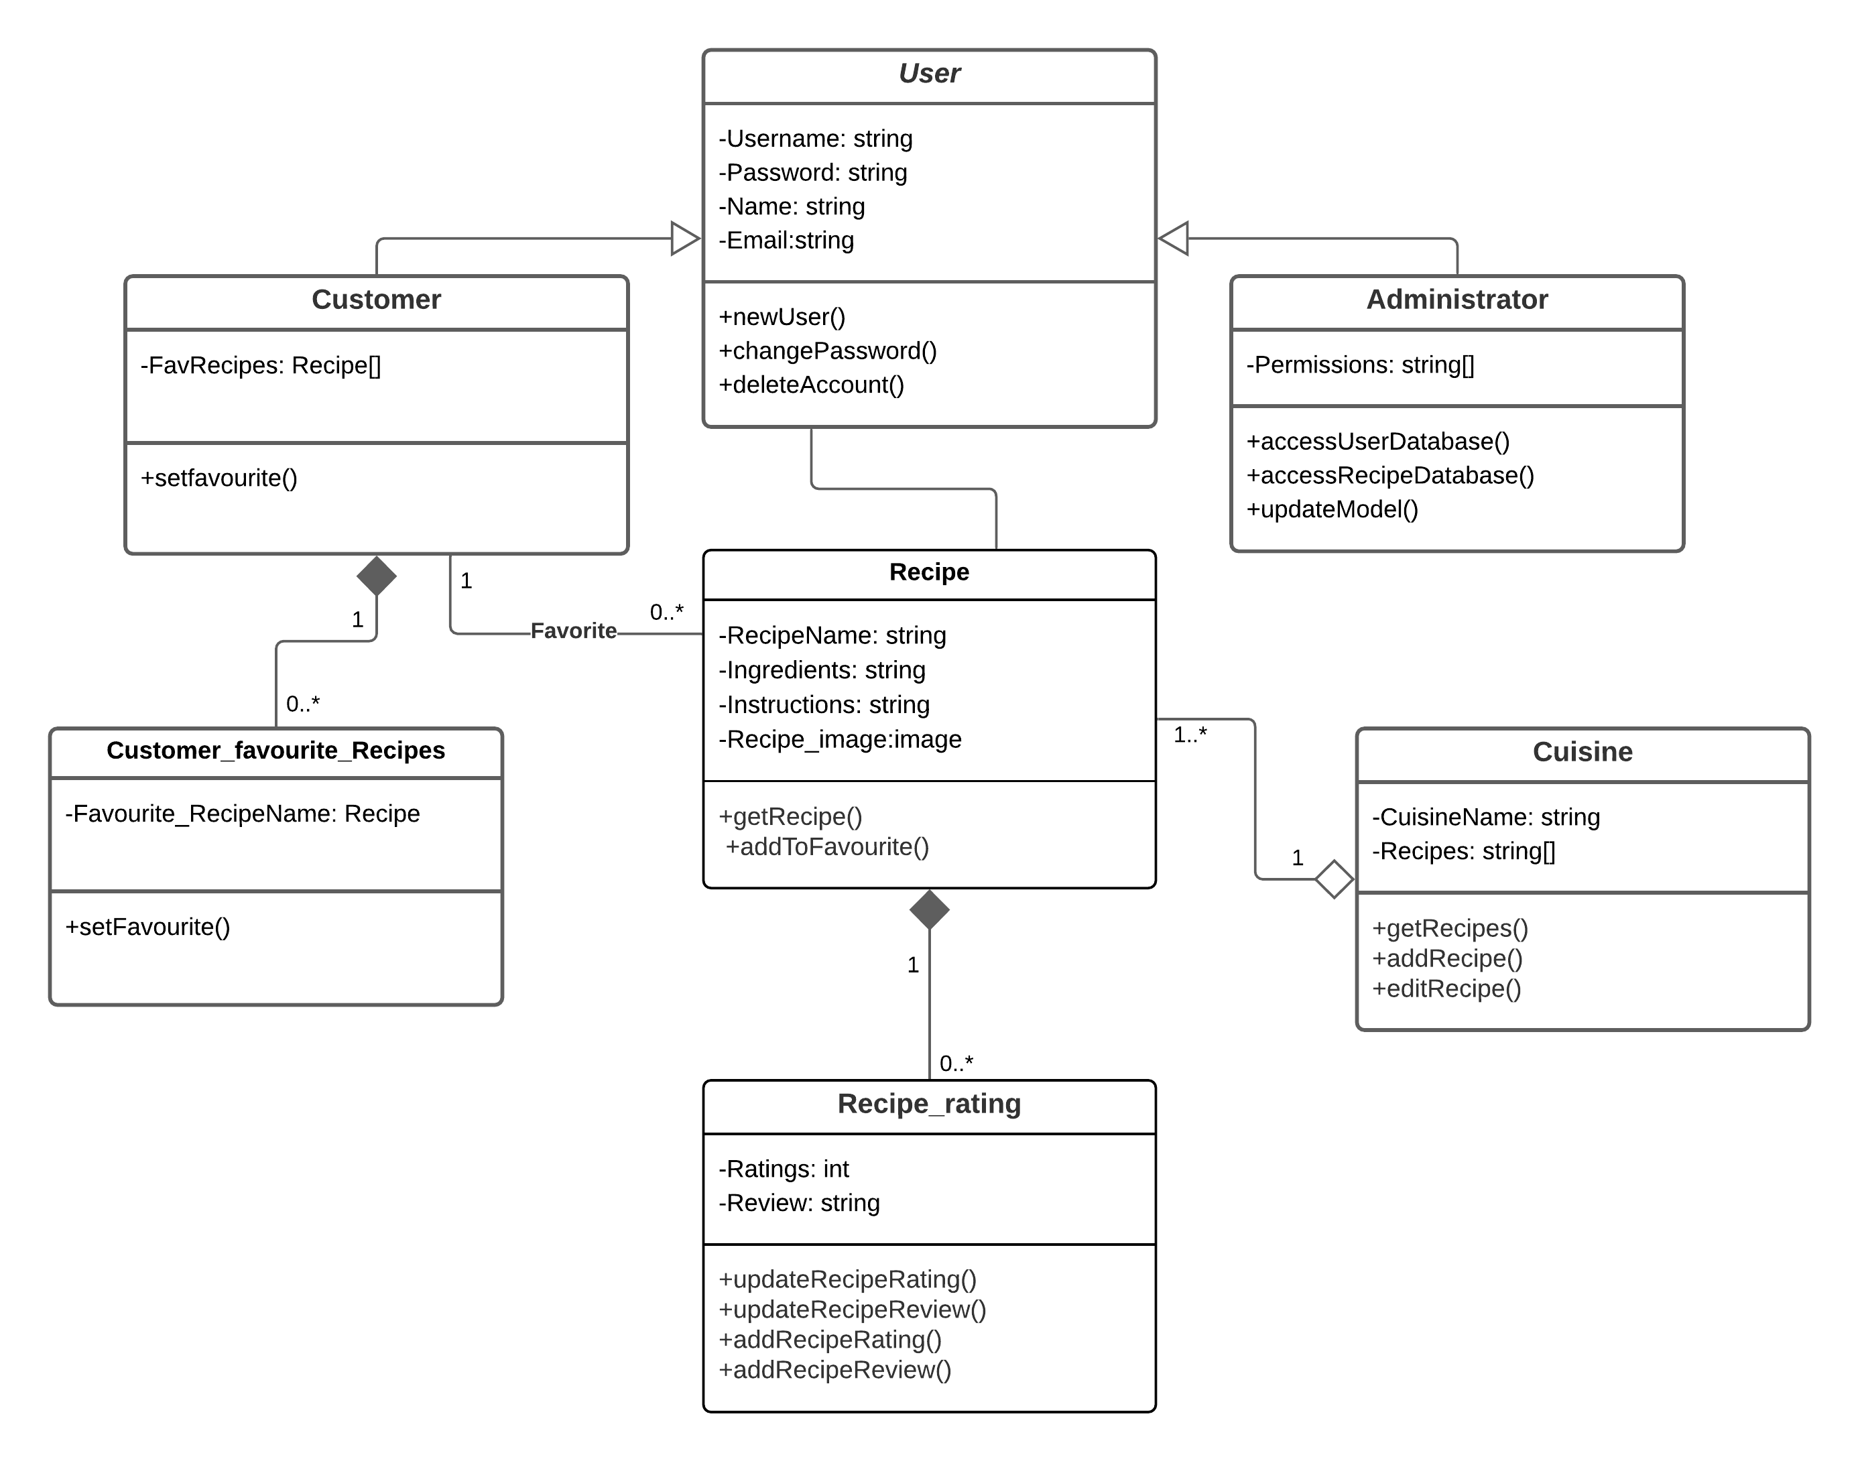
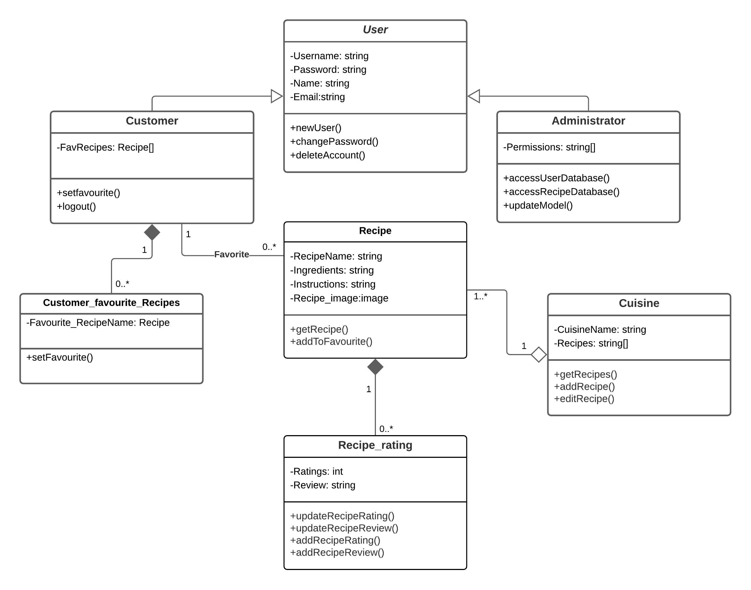

Slide 18
SEQUENCE
DIAGRAM

Slide 19
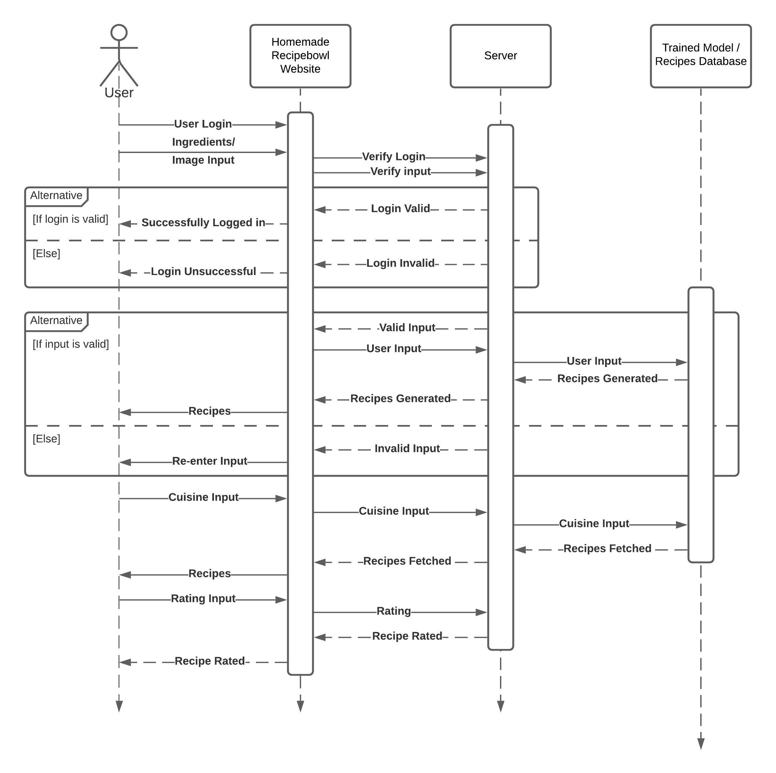
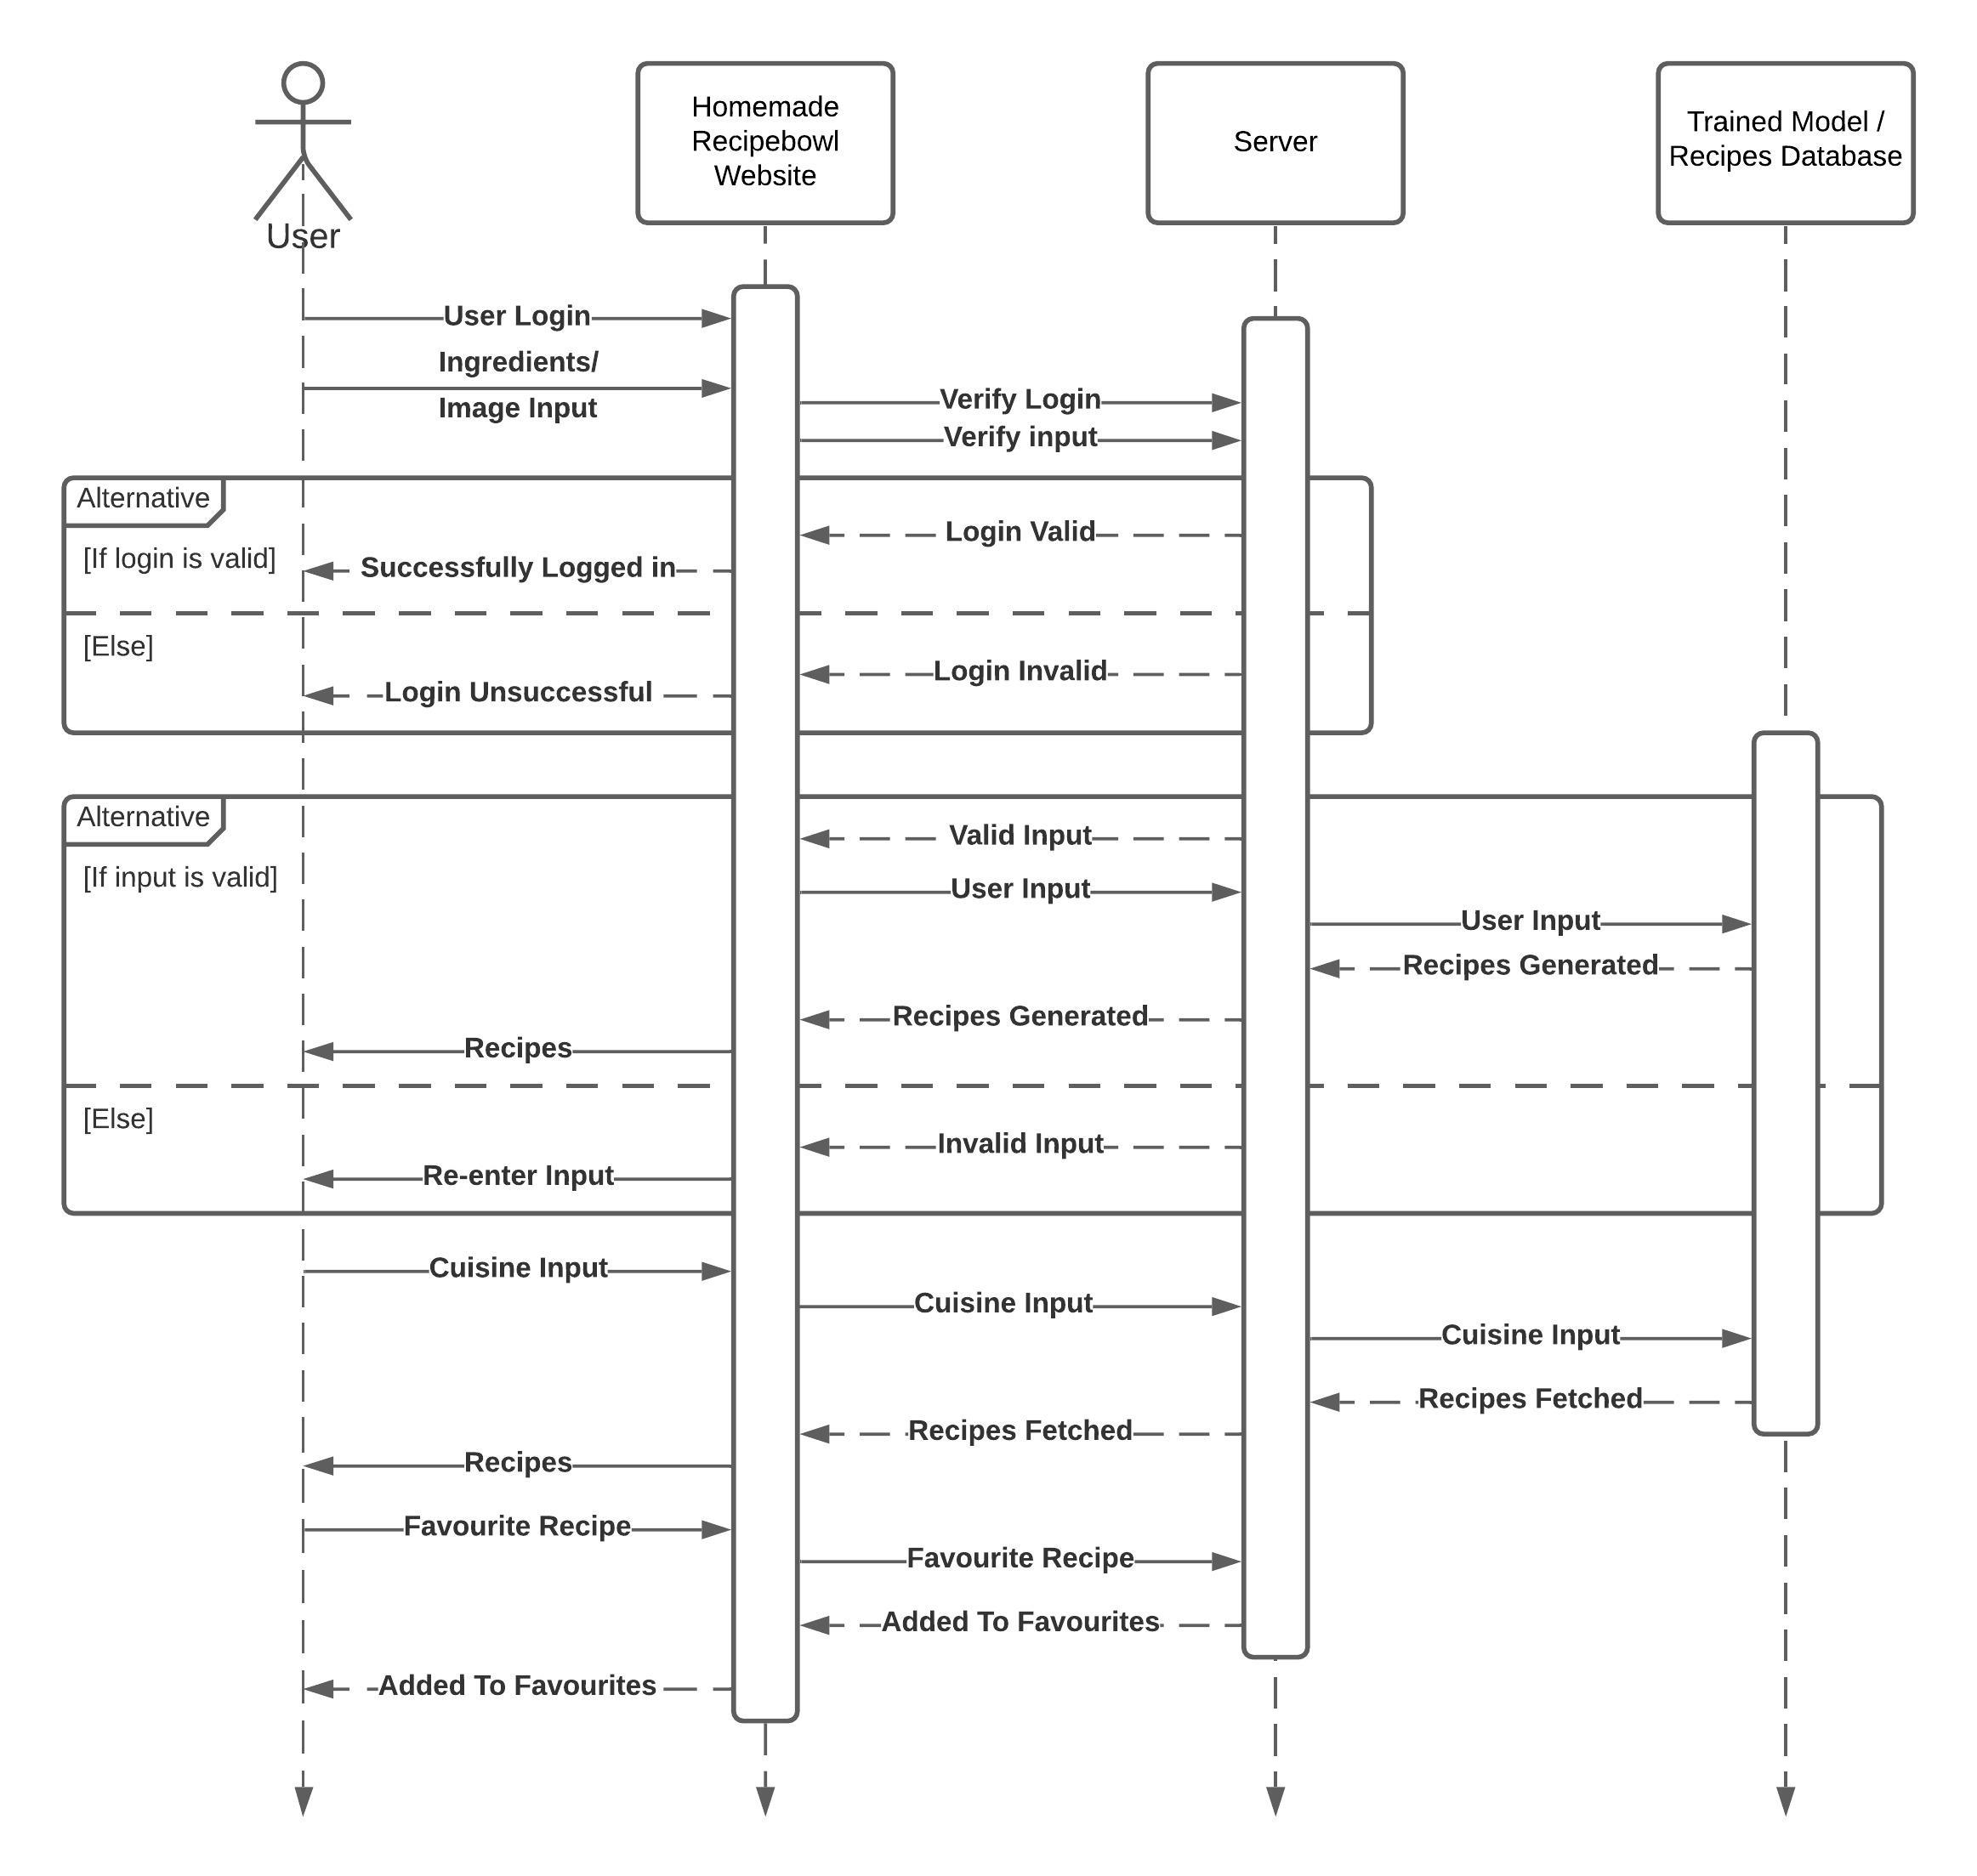

Slide 20
ACTIVITY
DIAGRAM

Slide 21
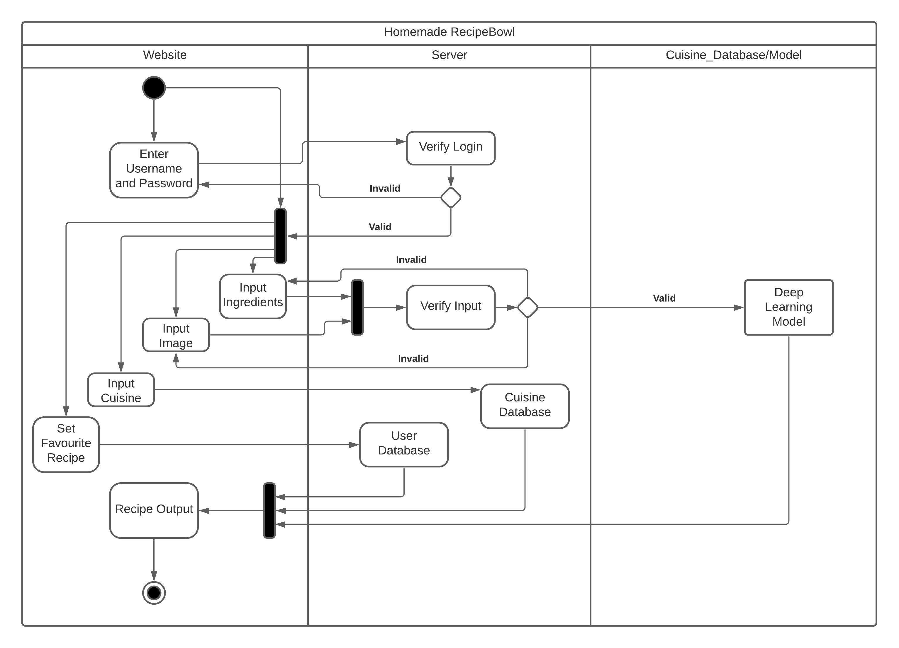
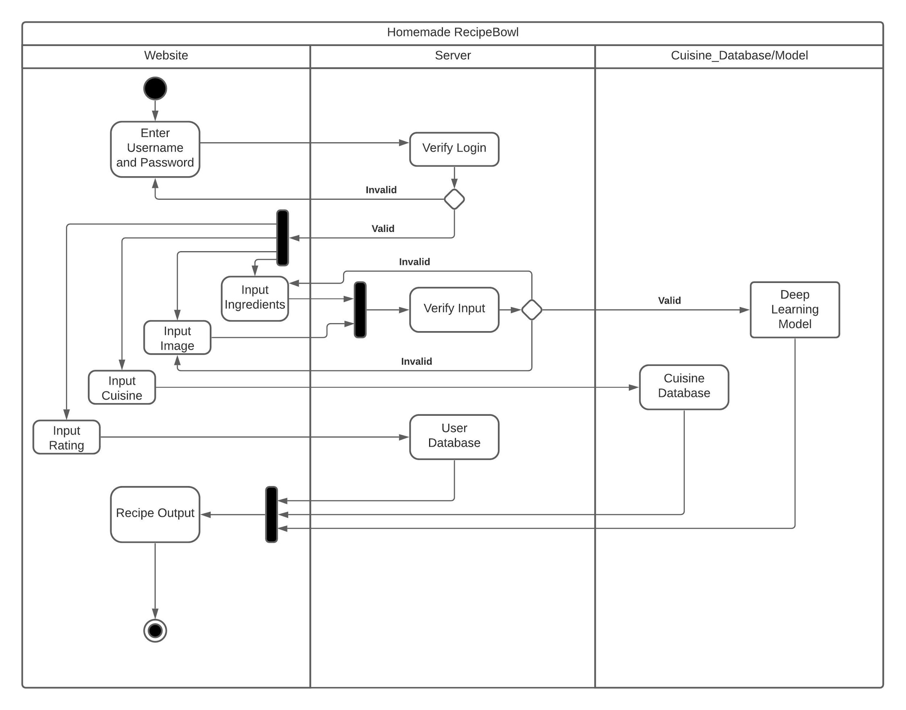
Model

Slide 22
STATE
DIAGRAM

Slide 23
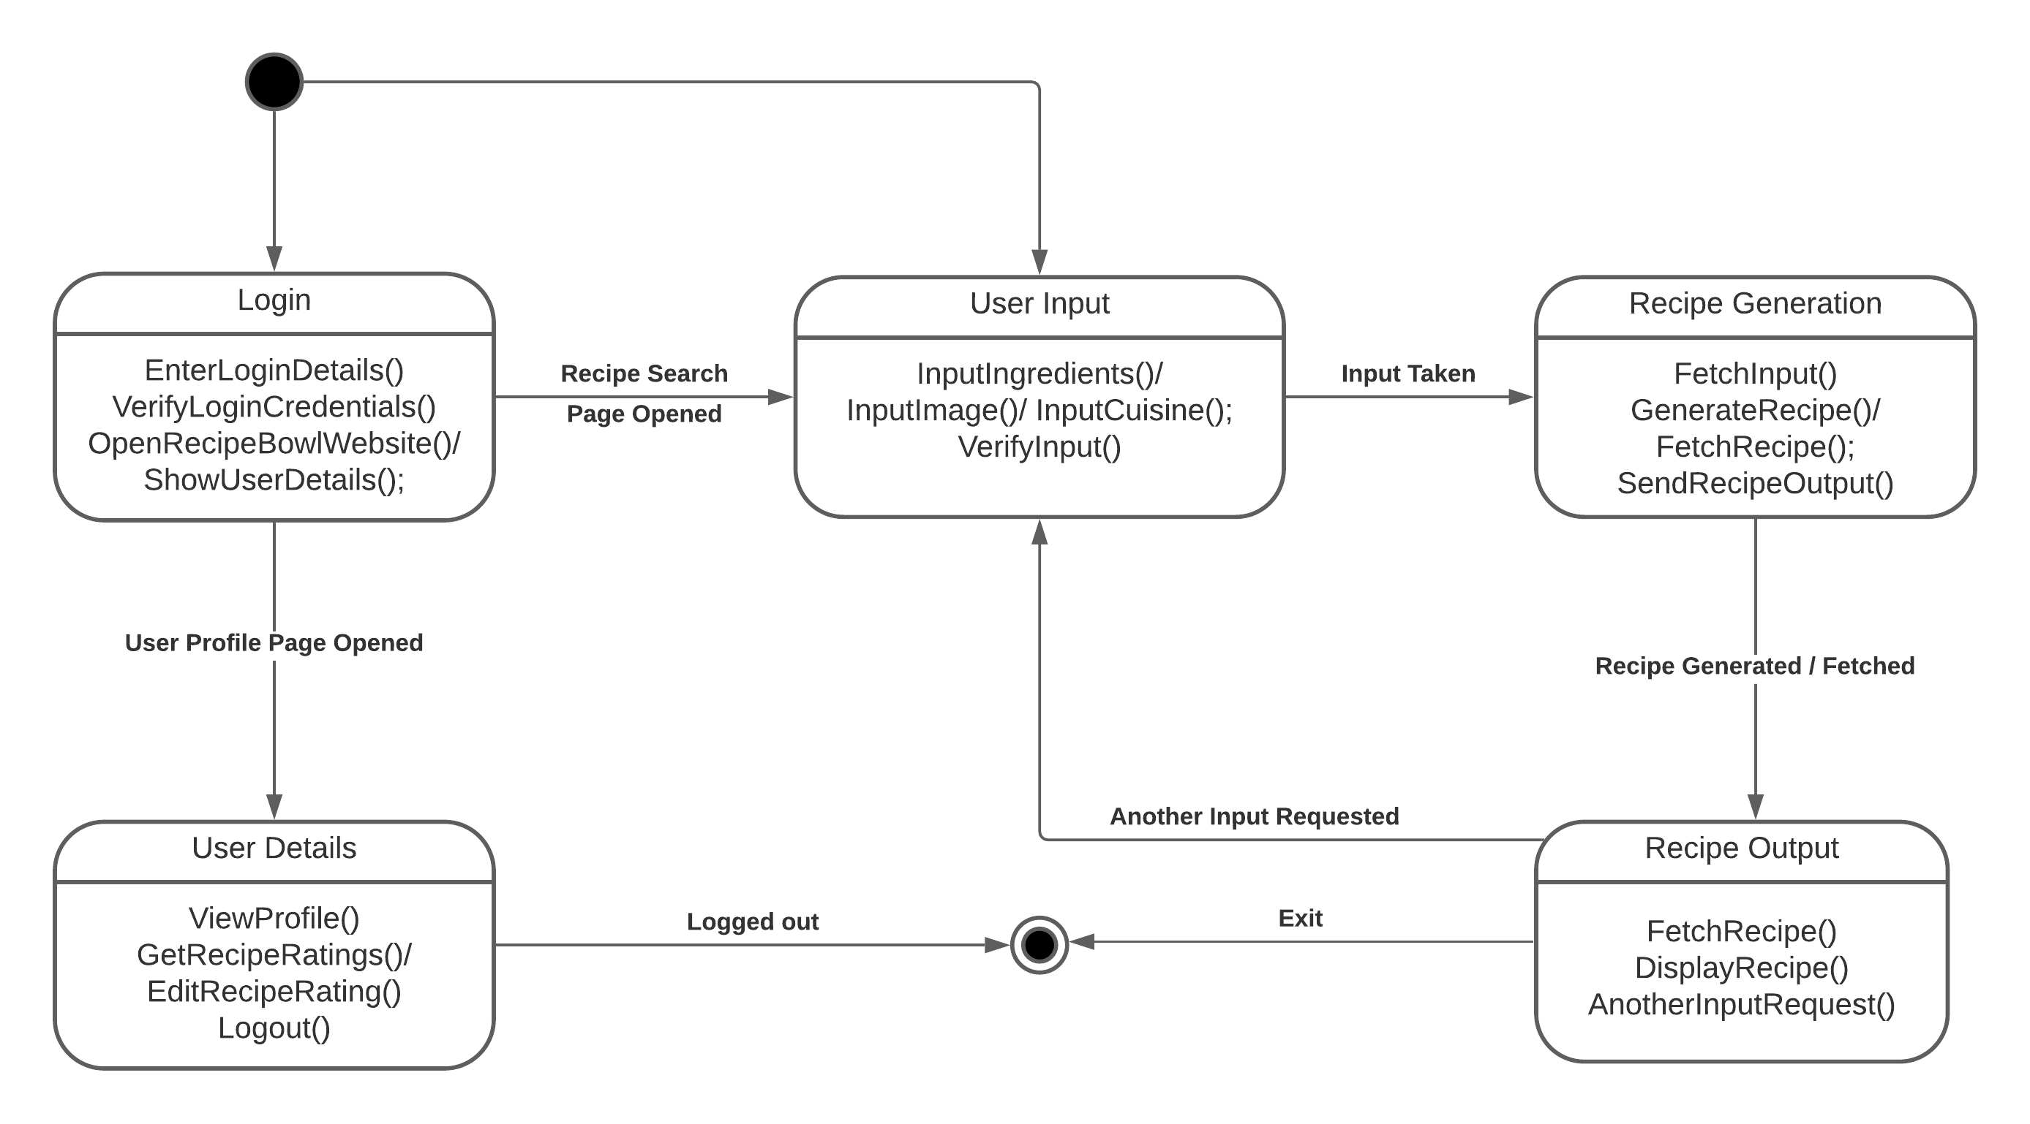
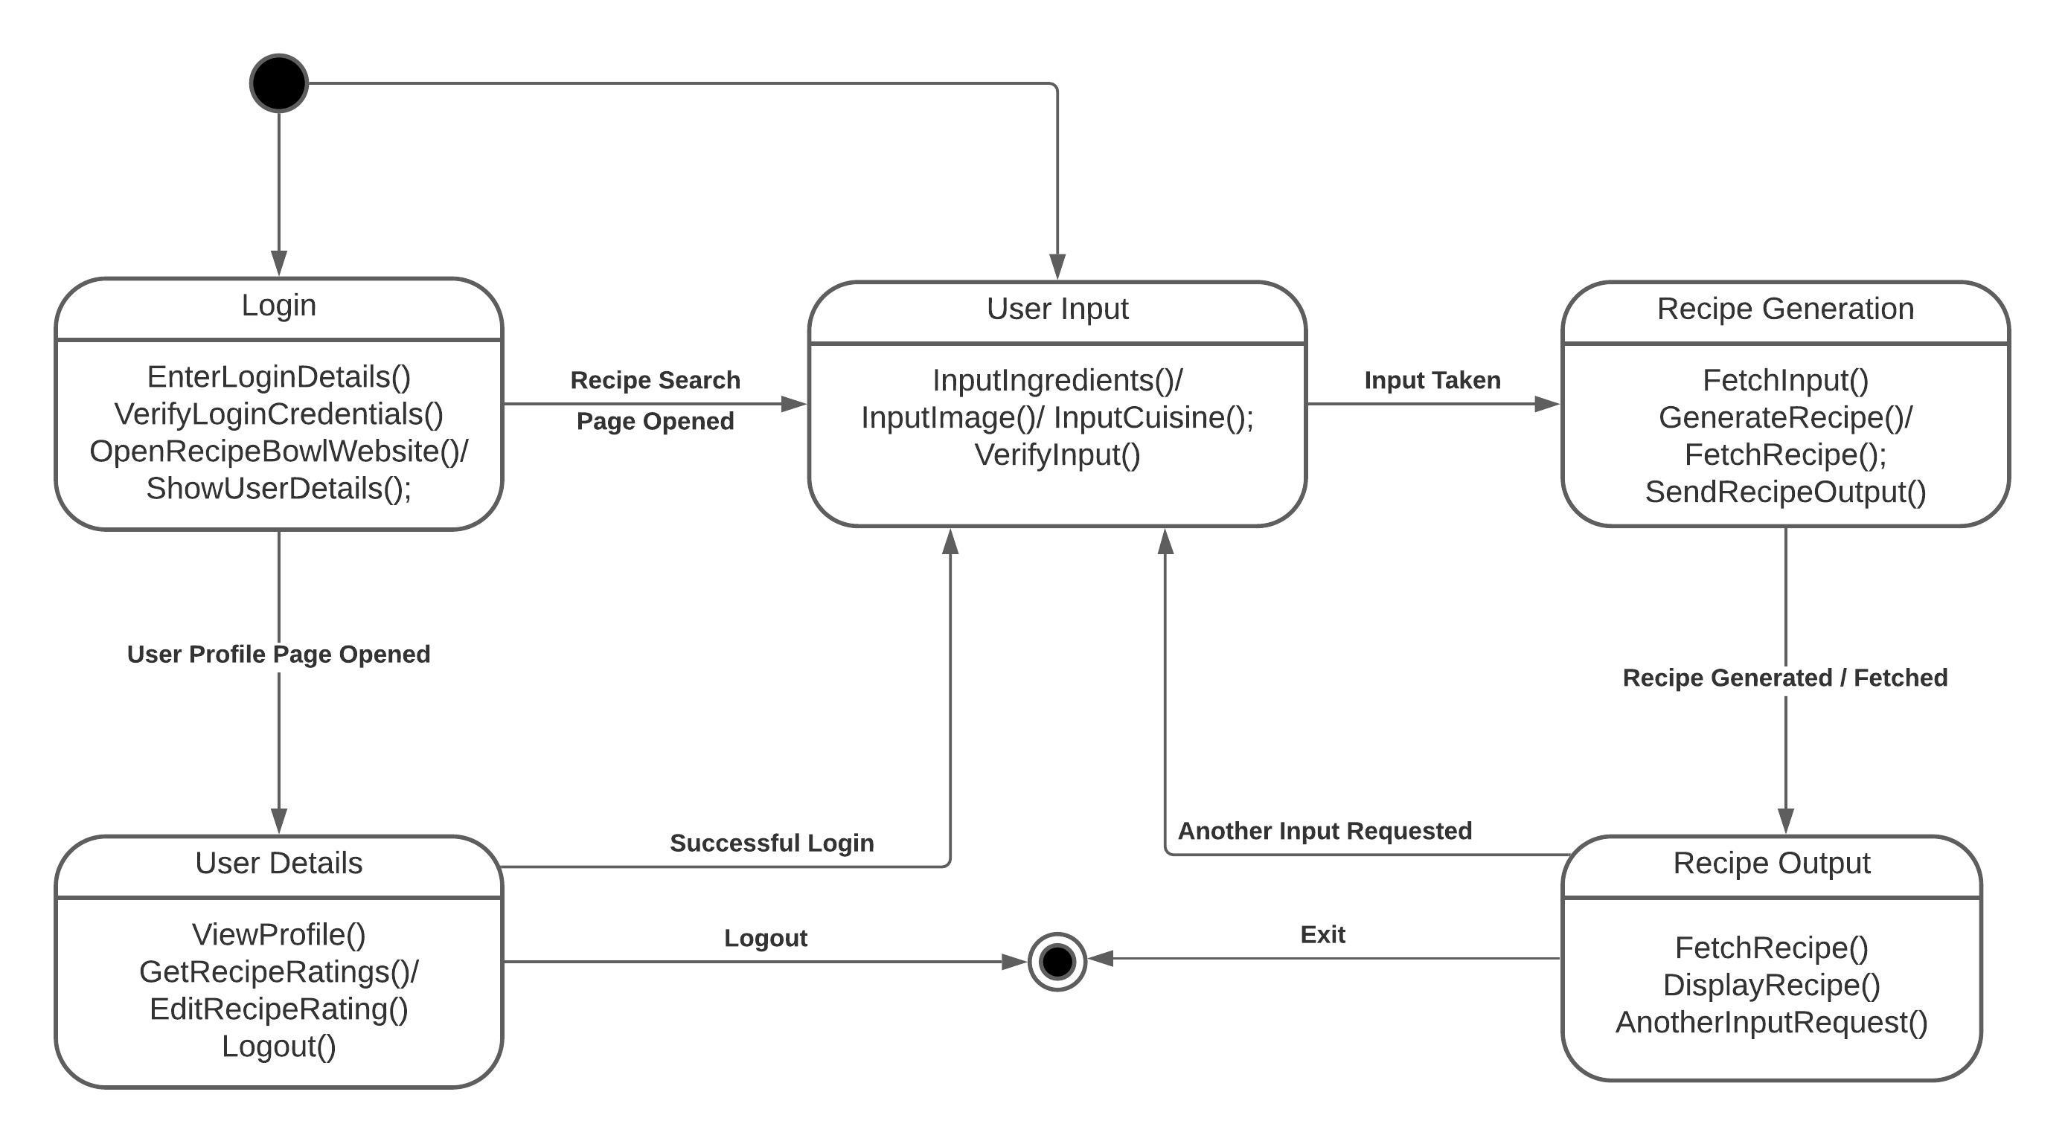

Slide 24
Week 6
(14 September 2020 - 20 September 2020)
Writing code for training the model:
Drafted code in python using Google Colab for model training on input ingredients and giving recipes as the output.
Week 7
(21 September 2020 - 27 September 2020)
Training and Testing of the Model:
Trained the deep learning model over 20 epochs on Google Colab.
Tested the model and retrieved the output from the model.
Requested Prof. Poonam Saini for PEC’s DGX GPU access for further training as it was not feasible on Google Colab due to limited resources(13 GB RAM).

Slide 25
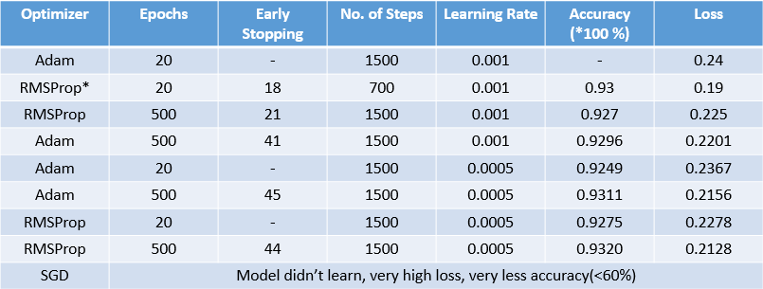
Week 8
(28 September 2020 - 4 October 2020)
Training the model on DGX’s GPU:
Trained and tested our model on PEC’s DGX GPU using docker and Teamviewer and extracted the following models:
Batch Size = 64
Loss Function = sparse_categorical_crossentropy
RMSProp*
VERY LARGE FLUCTUATIONS IN THE LOSS OVER CONSECUTIVE EPOCHS, SO NOT PREFERABLE
Selected Model

Slide 26
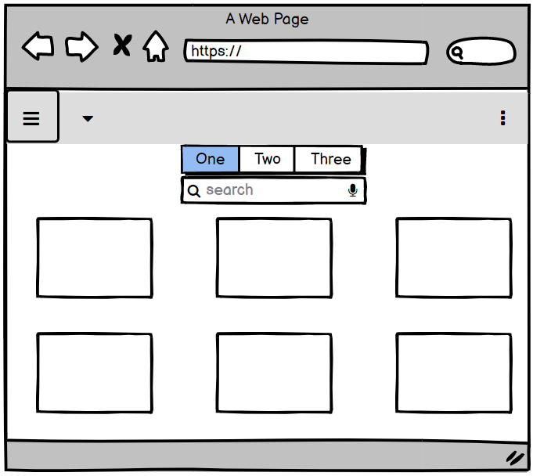
Week 9
(5 October 2020 - 11 October 2020)
Started developing the Website:
Started developing the
website’s front end using
the React Framework
Website Layout designed
before the start of actual
implementation by
team discussions and
brainstorming.
RecipeBowl
Wireframing done on https://balsamiq.com/

Slide 27
Week 10
(12 October 2020 - 18 October 2020)
Developing the Website backend and Integrating with front end:
Developing the website’s backend using the Flask framework of python.
Started integrating the frontend and the backend.
Continued with the frontend of the website.
Updated the Project SRS according to further scope of the project.

Slide 28
Updated Software Requirements Specification (SRS)
Purpose: to develop a system which primarily is capable of generating extensive recipes out of given set of ingredients.
Intended Audience:
Any person of any age group, any region and any profession who loves exploring food.
A very large size audience!!!
Scope:
Fetch/Scrap relevant dataset.
Decide upon apt deep learning technique for text generation.
Train the ML Model by varying hyper parameters.
Develop hitech and easy-to-use user interface system.

Slide 29
Product Features:
Ingredients-to-recipe feature
Image-to-recipe feature
Nutritional analysis for every recipe (relevant dataset was not available and web scraping was not feasible)
Cuisine and corresponding recipes feature.
Adding few other features to improve user experience.
User Interface Requirements:
Easy to use dynamic website which runs on exhaustive set of devices and which is capable of handling heavy user load.

Slide 30
Hardware Requirements:
High end computational machine required for Web Scraping and ML Model training if required.
Used PEC’s DGX GPU using docker and Teamviewer for training ML Models.
Software Requirements:
3rd Party dependencies required for Web Scraping (like BeautifulSoup, JSoup), Model Training script (like Tensorflow, Keras, Pytorch) and Web interfaces (React or Vue for frontend, Flask, Express or Django for backend).

Slide 31
Week 11
(19 October 2020 - 25 October 2020)
Exploring Image-to-Recipe datasets and websites for scrapping (if required):
Could not get the most diverse MIT dataset from the given portal (portal wasn’t working).
Tried exploring some other websites which could help us with the Image to Recipes training process.
Chefkoch (has multiple images for many single recipes)
Started the scraping of the dataset.

Slide 32
Week 12
(26 October 2020 - 1 November 2020)
Completed scrapping and started preparing model training code:
Completed the scrapping process of ChefKoch website.
Started development of the model training code using CNNs for image identification and RNNs for recipe generation, and achieved an accuracy of about 93.56% using our ChefKoch scraped dataset.
Continued development of website by adding certain features to it(login page).
Started scraping websites to get dataset for Cuisine-to-Recipe.

Slide 33
Week 13
(2 November 2020 - 8 November 2020)
Further Developed the RecipeBowl Website:
Developed the website’s front end using the React framework.
Added additional features/components like login page, user dashboard, favourite recipe feature, about us page.
Integrated front end components with each other.
Integrated front end with image-to-recipe feature and cuisine-to-recipe feature.

Slide 34
Further Scope Of The Project...
CURRENT CHALLENGES:
The Ingredients-to-Recipe generator sometimes produces irrelevant outputs, due to constraint on dataset size.
FURTHER SCOPE:
Expanding our dataset and improving the text generation model.
The Ingredients-to-recipe model can be further extended to image generation corresponding to the recipe generated.
A Post’s feed can be added to the website where people can add their recipes in the form of posts.
Discussion forum for Q/A among the users.

Slide 35


